Slide 1
Network Theory:
Project Pitch
Joe Shymanski

Slide 2
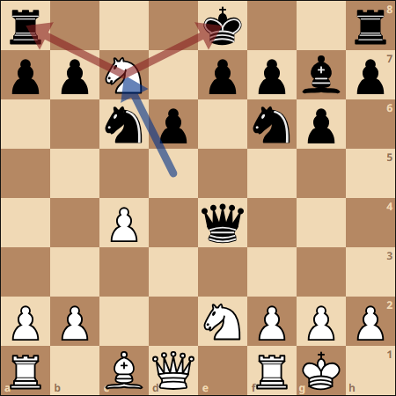
What Makes an Explanation Good?
Actionable
“This move forks the king and the rook.”
Placebic
“This move is your most advantageous option.”

Slide 3
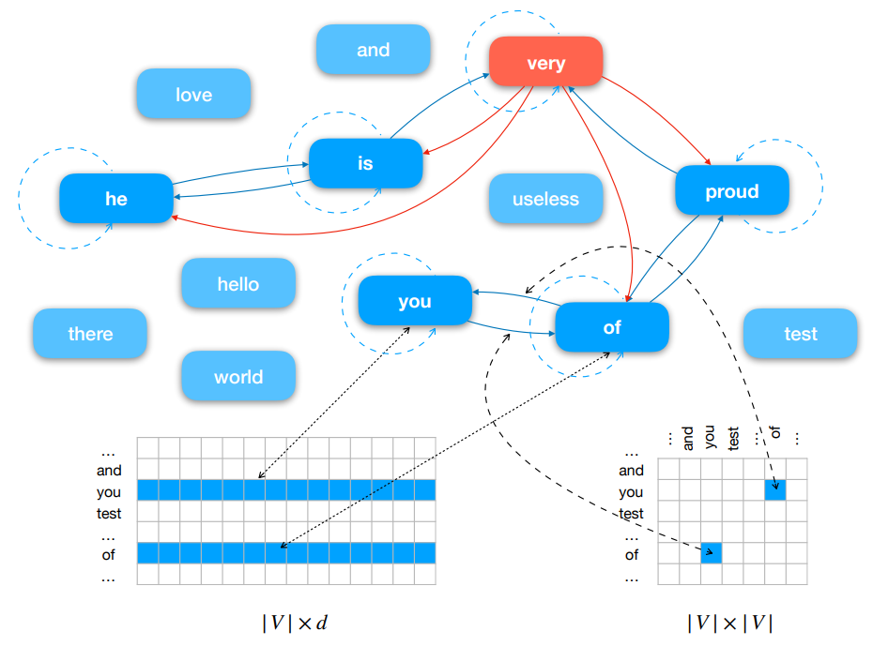
Text Graph
All words are represented as nodes.
Each word in a text is connected with an edge.
Learn edge weights / node representations to classify a text.

Slide 4
GNN Solution
Text Level Graph Neural Network for Text Classification by Huang et al. (2019)
Word/node representations are word embeddings which can be updated.
Message Passing Mechanism (MPM) for convolution
Non-spectral method
Parameter p determines neighborhood of edge connections
Updates edge weights and node representations

Slide 5
Python Libraries for Graph Deep Learning
Deep Graph Library (DGL)
PyTorch Geometric (PyG)
Graph Nets
Spektral

Slide 6
References
Huang, L., Ma, D., Li, S., Zhang, X., & Wang, H. (2019). Text level graph neural network for text classification. arXiv preprint arXiv:1910.02356.
Yao, L., Mao, C., & Luo, Y. (2019, July). Graph convolutional networks for text classification. In Proceedings of the AAAI conference on artificial intelligence (Vol. 33, No. 01, pp. 7370-7377).
Zhang, M., Cui, Z., Neumann, M., & Chen, Y. (2018, April). An end-to-end deep learning architecture for graph classification. In Proceedings of the AAAI conference on artificial intelligence (Vol. 32, No. 1).
Zhou, J., Cui, G., Hu, S., Zhang, Z., Yang, C., Liu, Z., ... & Sun, M. (2020). Graph neural networks: A review of methods and applications. AI open, 1, 57-81.

